Slide 1
C11.a
A Career in Bioinformatics?
And non-RNASeq workflows

Slide 2
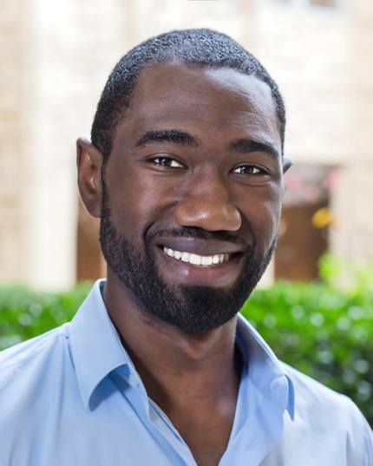











Joel Babdor, PhD.
Postoctoral researcher, Spitzer Lab [USCF]
@BlackInImmuno
www.blackinimmuno.org
@ImmunoDiverse
@JoelBabdor
joel.babdor@ucsf.edu
Notes:
Want to know if you encounter unwelcoming behavior outside or inside classroom

Slide 3
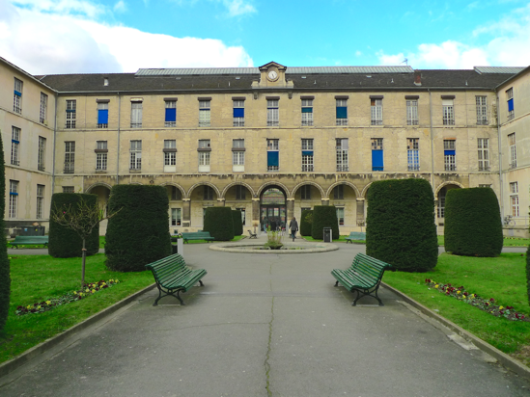
My journey in science
Paris-Descartes University
Paris
van Endert / Saveanu Lab
#Dendritic cell endosomal compartments
#Immune system regulation
#confocal microscopy
#Cell and molecular biology
Carré (square) Necker

Slide 4
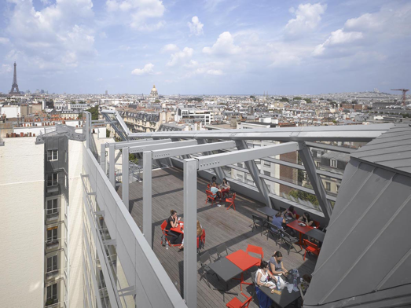
My journey in science
Paris-Descartes University
Paris
Imagine Institute
Paris
van Endert / Saveanu Lab
#Dendritic cell endosomal compartments
#Immune system regulation
#confocal microscopy
#Cell and molecular biology
Hermine lab
#Cancer immunology
#Immunotherapy
#in vivo
Carré (square) Necker
Imagine
Rooftop

Slide 5
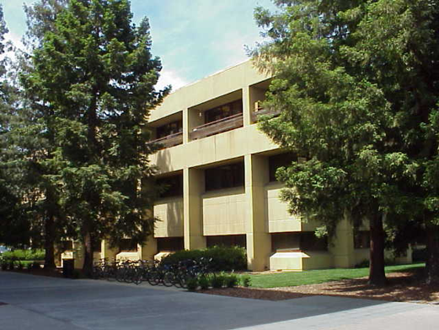
My journey in science
Paris-Descartes University
Paris
Imagine Institute
Paris
Stanford
Microbiology & Immunology
van Endert / Saveanu Lab
#Dendritic cell endosomal compartments
#Immune system regulation
#confocal microscopy
#Cell and molecular biology
Hermine lab
#Cancer immunology
#Immunotherapy
#in vivo
Idoyaga lab
#Dendritic cell physiology
#Cancer immunotherapy
#Single cell flow cytometry
Carré (square) Necker
Imagine
Rooftop
Fairchild Building
redwoods’ shade

Slide 6
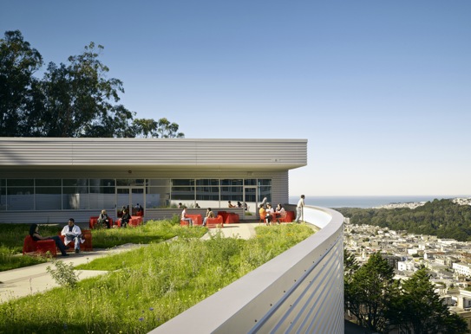
My journey in science
Paris-Descartes University
Paris
Imagine Institute
Paris
Stanford
Microbiology & Immunology
UCSF
San Francisco
van Endert / Saveanu Lab
#Dendritic cell endosomal compartments
#Immune system regulation
#confocal microscopy
#Cell and molecular biology
Hermine lab
#Cancer immunology
#Immunotherapy
#in vivo
Idoyaga lab
#Dendritic cell physiology
#Cancer immunotherapy
#Single cell flow cytometry
Spitzer lab
#Single cell mass cytometry
#Computationnal / systems Immunology
#R coding
#Microbiome metagenomic/metabolomic
#Translational/clinical research
Carré (square) Necker
Imagine
Rooftop
Fairchild Building
redwoods’ shade
Stem cell building
Rooftop

Slide 7
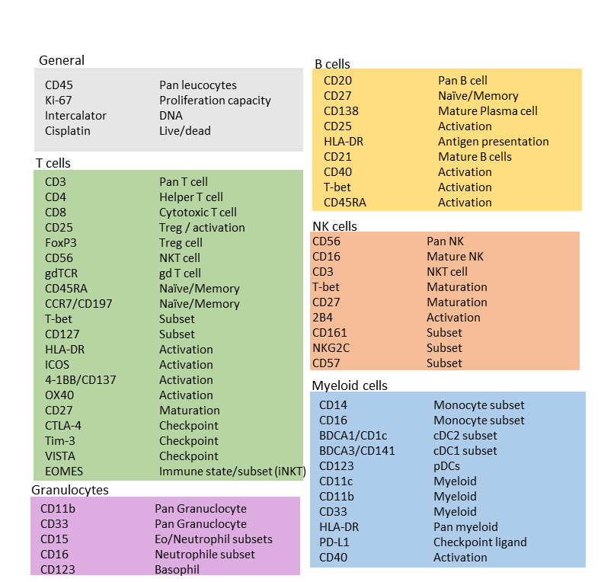
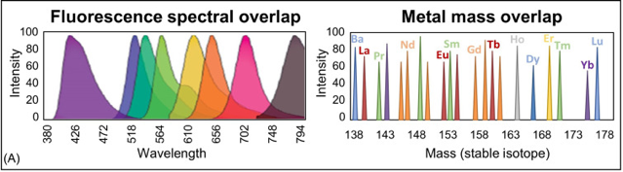
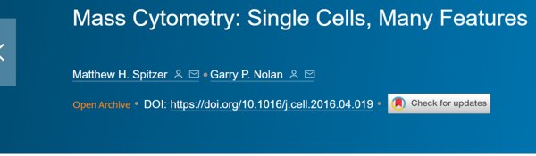

Mass Cytometry - Single cells Many features
CYTOF
Mass cytometry
Spitzer et al. Cell. 2016

Slide 8
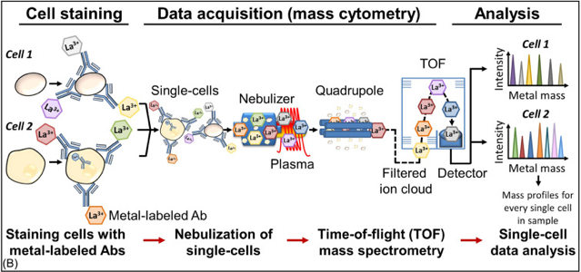
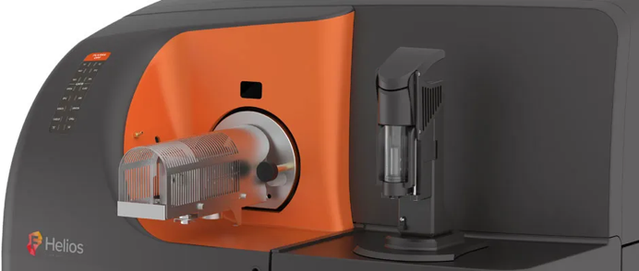
Mass Cytometry - Single cells Many features
CYTOF
Mass cytometry
Data
generation
Spitzer et al. Cell. 2016

Slide 9
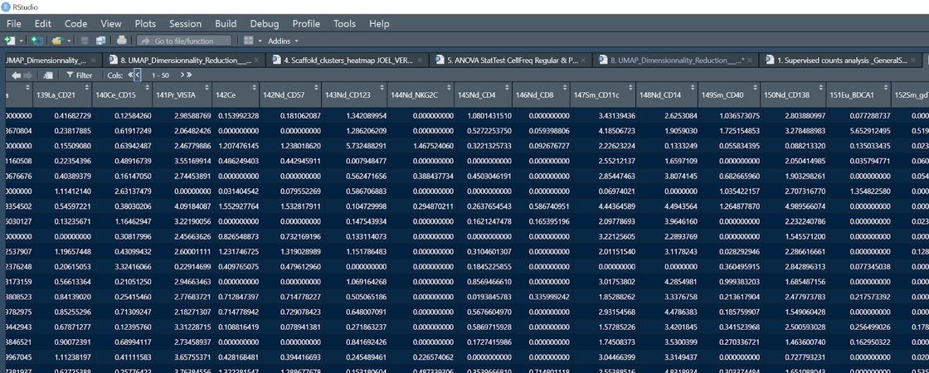
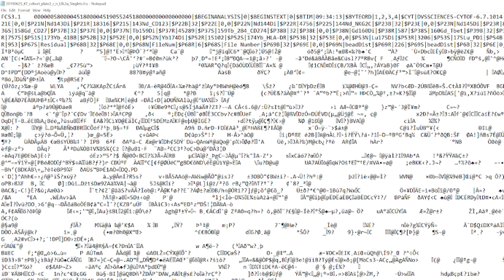
Mass Cytometry - Single cells Many features
CYTOF
Mass cytometry
Data
generation
Spitzer et al. Cell. 2016
High
Dimensional
Data

Slide 10
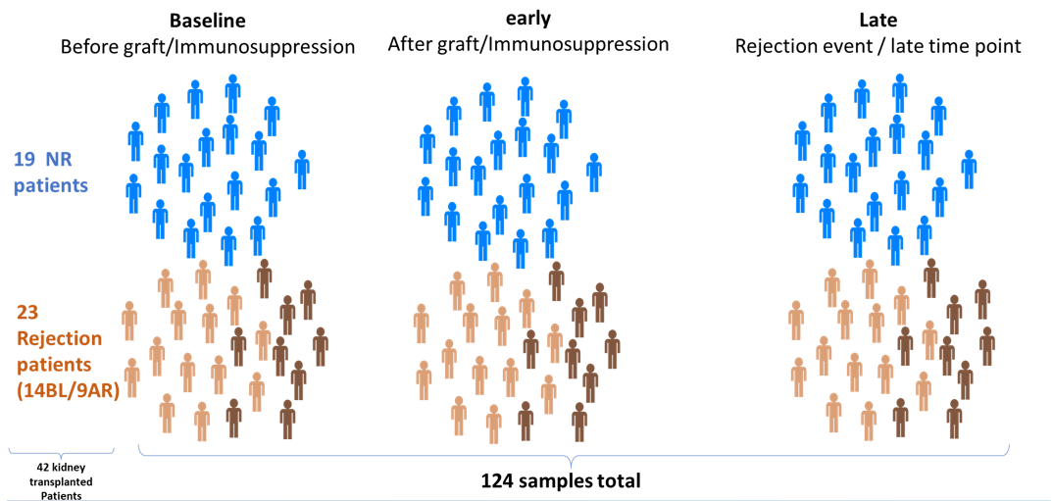
My computational workflow
Kidney transplant cohort
Longitudinal immunophenotyping
Treatment = graft + Immunosuppression

Slide 11
My computational workflow
Input
Function description
Output
Clara clustering
+ UMAP Dimensionality reduction
200 clusters
+ UMAP coordinates single cells
Single cell
marker expression dataframe
1
UMAP
Pipeline
2
3
5
4
ggplot- geom_point
UMAP X & Y coordinates
Single cell visualization - 2D plot

Slide 12
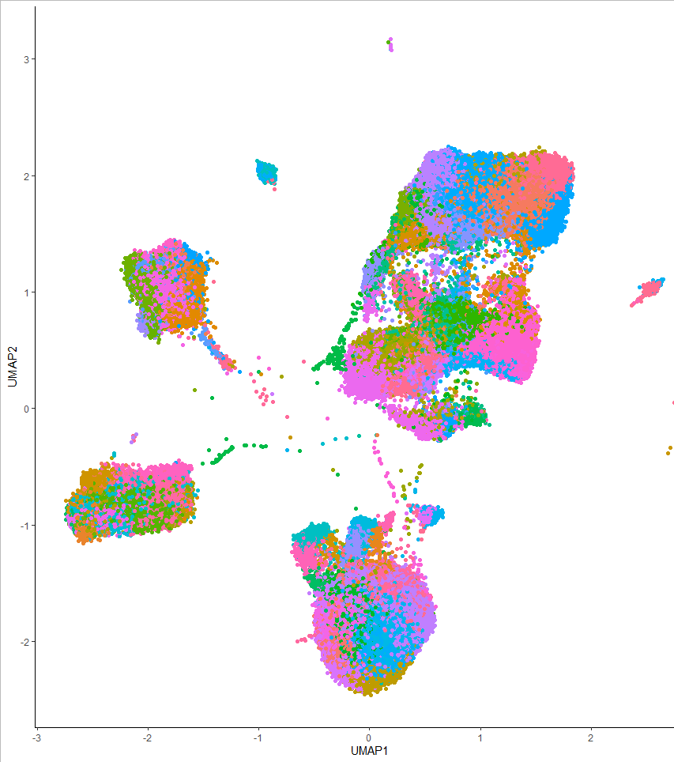
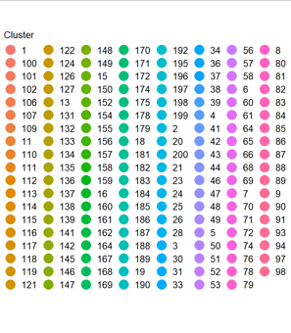
My computational workflow

Slide 13
My computational workflow
Input
Function description
Output
Clara clustering
+ UMAP Dimensionality reduction
200 clusters
+ UMAP coordinates single cells
Single cell
marker expression dataframe
1
Stratified subsetting
Single cell dataframe
<= N cells from each clusters
UMAP
Pipeline
2
Hierarchical clustering
HeatMap expression
Dendrogram partition ID
partition/cluster overlap
3
5
4

Slide 14
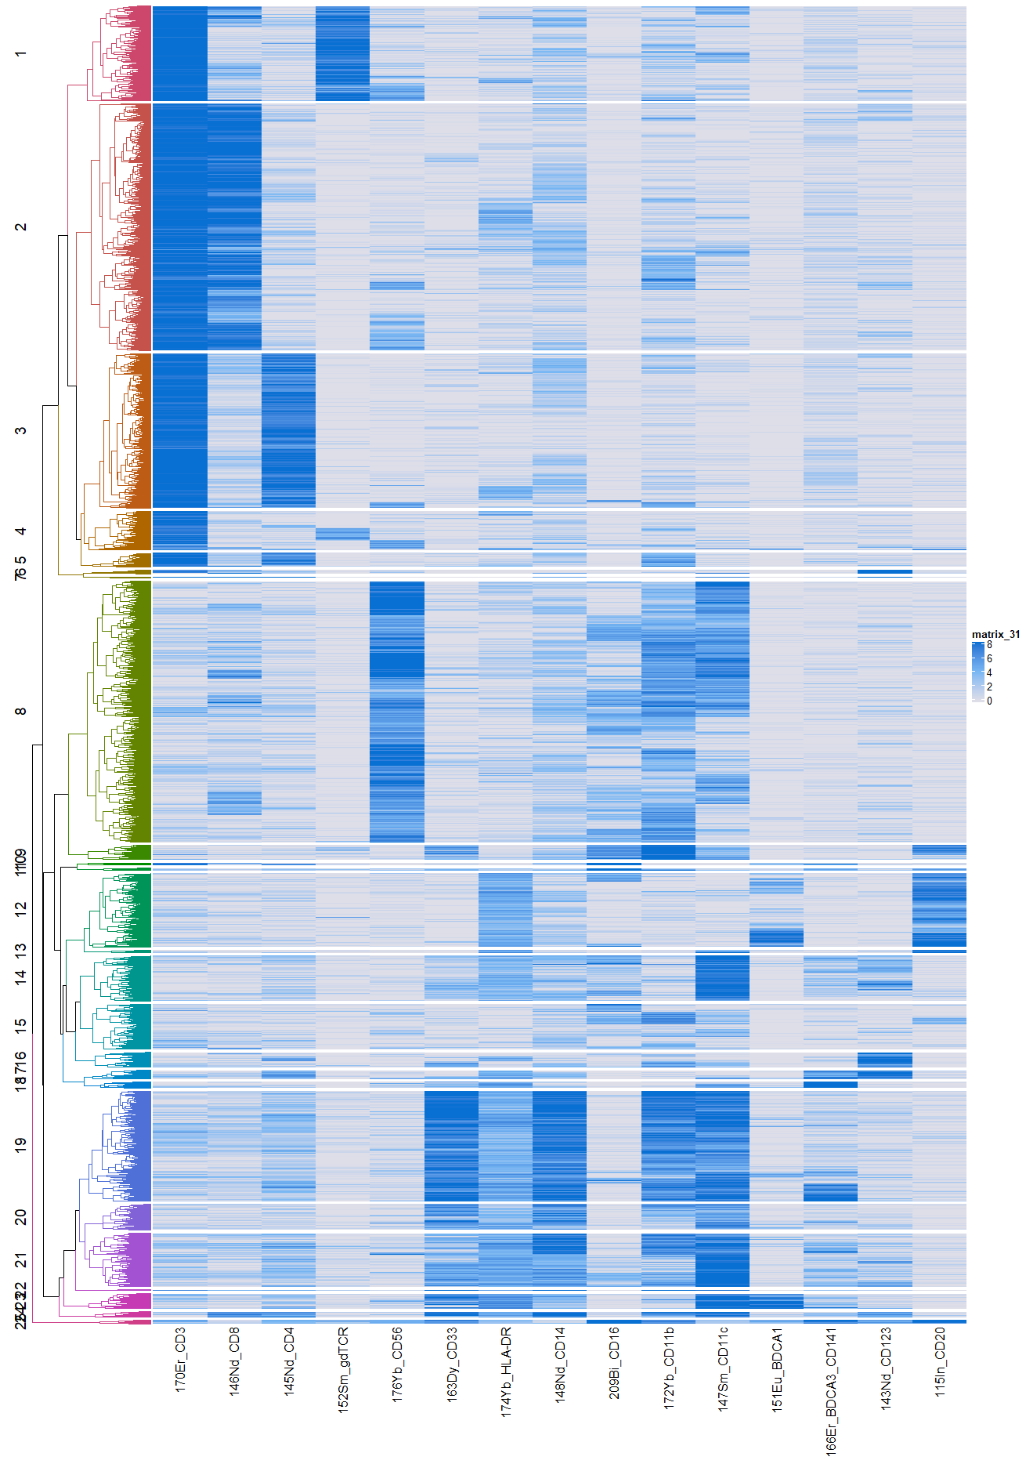
My computational workflow

Slide 15
My computational workflow
Input
Function description
Output
Clara clustering
+ UMAP Dimensionality reduction
200 clusters
+ UMAP coordinates single cells
Single cell
marker expression dataframe
1
Stratified subsetting
Single cell dataframe
<= N cells from each clusters
UMAP
Pipeline
2
Hierarchical clustering
HeatMap expression
Dendrogram partition ID
partition/cluster overlap
3
5
4
ggplot- geom_point
UMAP X & Y coordinates
Single cell visualization - 2D plot

Slide 16
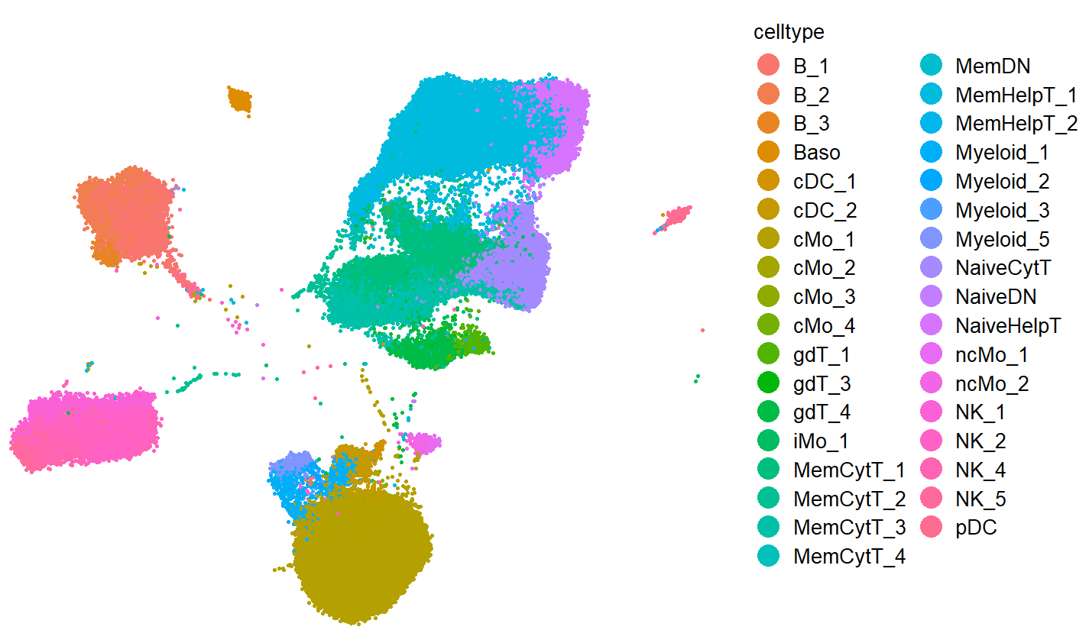
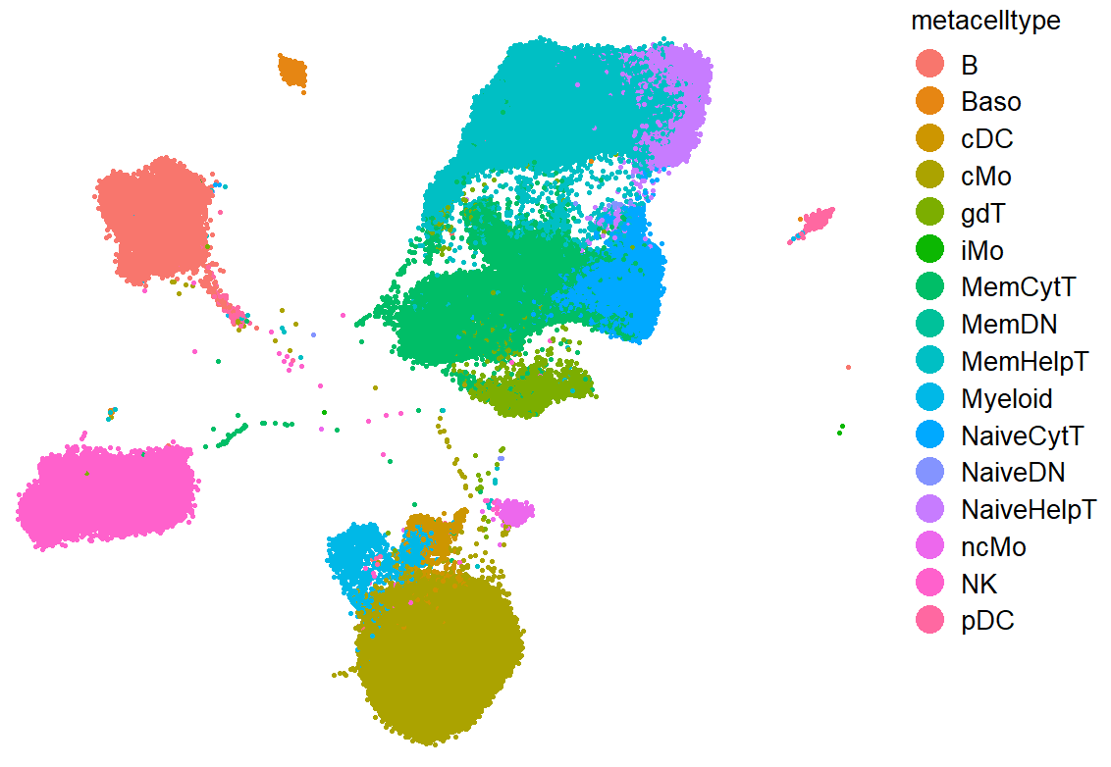
My computational workflow

Slide 17
My computational workflow
Input
Function description
Output
Clara clustering
+ UMAP Dimensionality reduction
200 clusters
+ UMAP coordinates single cells
Single cell
marker expression dataframe
1
Stratified subsetting
Single cell dataframe
<= N cells from each clusters
UMAP
Pipeline
2
Hierarchical clustering
HeatMap expression
Dendrogram partition ID
partition/cluster overlap
3
5
4
ggplot- geom_point
UMAP X & Y coordinates
Single cell visualization - 2D plot
Cell frequency at different level
Cluster / cell type / cell subset frequency data frame

Slide 18
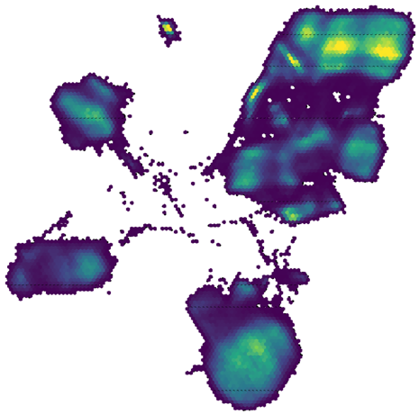
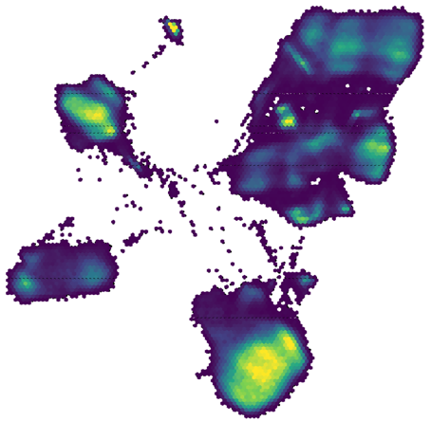
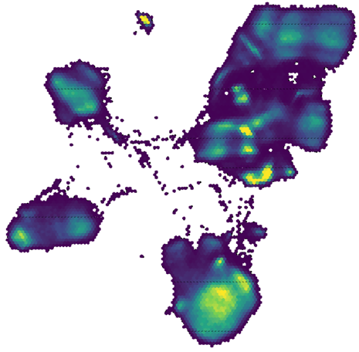
My computational workflow
Kidney transplant cohort
Longitudinal immunophenotyping
Treatment = graft + Immunosuppression
Baseline
Early
Late

Slide 19




Chiranjit ‘Ran’ Mukherjee, PhD
Postdoctoral Fellow,
Biotechnology & Planetary Protection Group,
NASA Jet Propulsion Laboratory,
California Institute of Technology, Pasadena, Ca.
Research Associate II,
Div. of Biosciences,
College of Dentistry,
The Ohio State University, Columbus, Ohio.
@drcmicro
The Ohio State University

Slide 20
Career Path
Graduate from OSU
(MS Microbiology)
2013
Worked as GTA, teaching microbiology courses
QC Microbiologist at PharmaForce Inc. in Columbus, Ohio
2011
Arrived in the US
&
Started graduate school at
Ohio State University, Columbus, Ohio
2014
Started work at OSU College of Dentistry as Research Associate (Microbiome Bioinformatics)

Slide 21
Career Path
Graduate from OSU
(MS Microbiology)
Graduate from OSU
(PhD Biomedical Sc.)
2013
2019
Worked as GTA, teaching microbiology courses
2016
Started PhD program at
Ohio State University College of Medicine
2020
Started Post Doctoral Fellowship at NASA JPL
&
Continuing as Research Associate II for OSU CoD
QC Microbiologist at PharmaForce Inc. in Columbus, Ohio
2011
Arrived in the US
&
Started graduate school at
Ohio State University, Columbus, Ohio
2014
Started work at OSU College of Dentistry as Research Associate (Microbiome Bioinformatics)
Started as Post Doctoral Researcher at OSU CoD

Slide 22
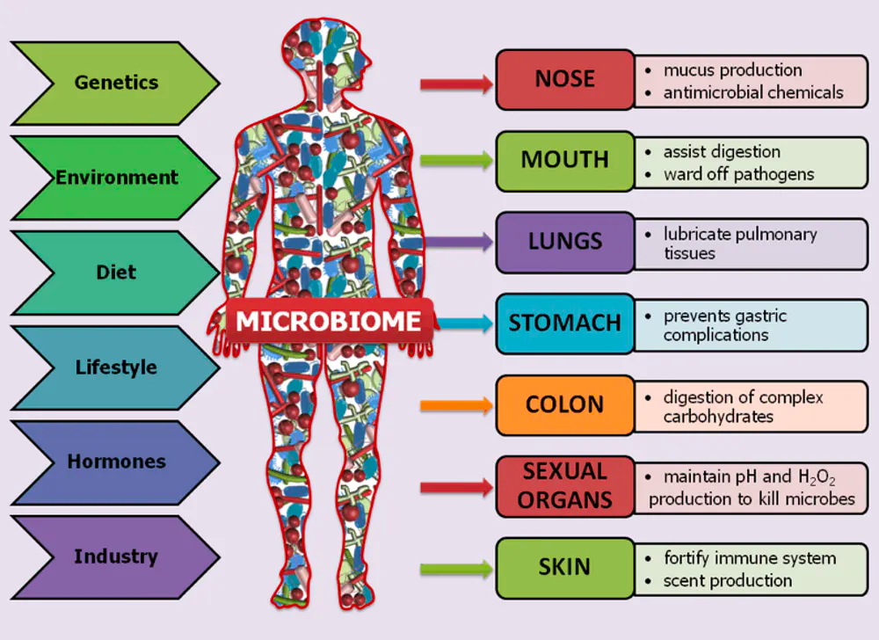
The Human Microbiome
Aggregate of all microbial genetic material that reside on/within human body
Genetic material from these bacteria, fungi etc. also influence our health & well being
Modern Sequencing Technologies + Bioinformatics = culture-independent microbiome studies!

Slide 23
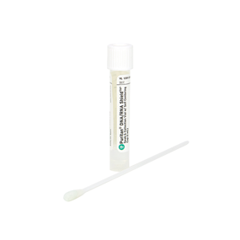
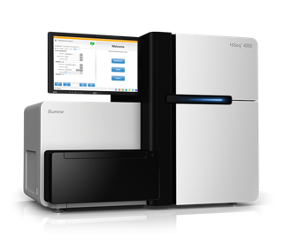
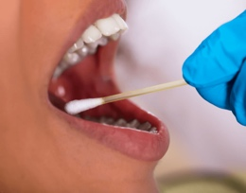
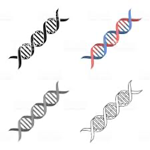
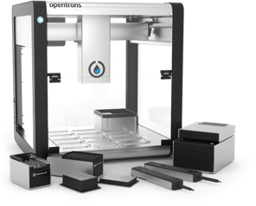

Microbiome Research Workflow
Sample Collection
DNA Extraction
Genomic Library Preparation
High-Throughput Sequencing
Data Analysis
23

Slide 24
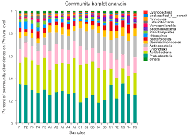
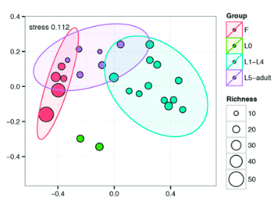
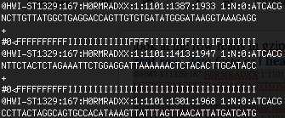
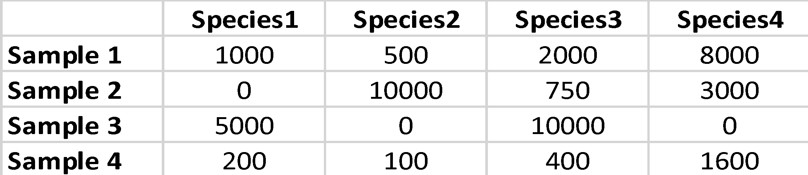
Microbiome Research Workflow
Sample Collection
DNA Extraction
Genomic Library Preparation
High-Throughput Sequencing
Data Analysis
Raw Sequence Data
(FASTQ files)
Species Abundance Table
(High Dimensional Data)
Taxonomic Abundance Comparisons
Microbial Diversity Analysis
24

Slide 25
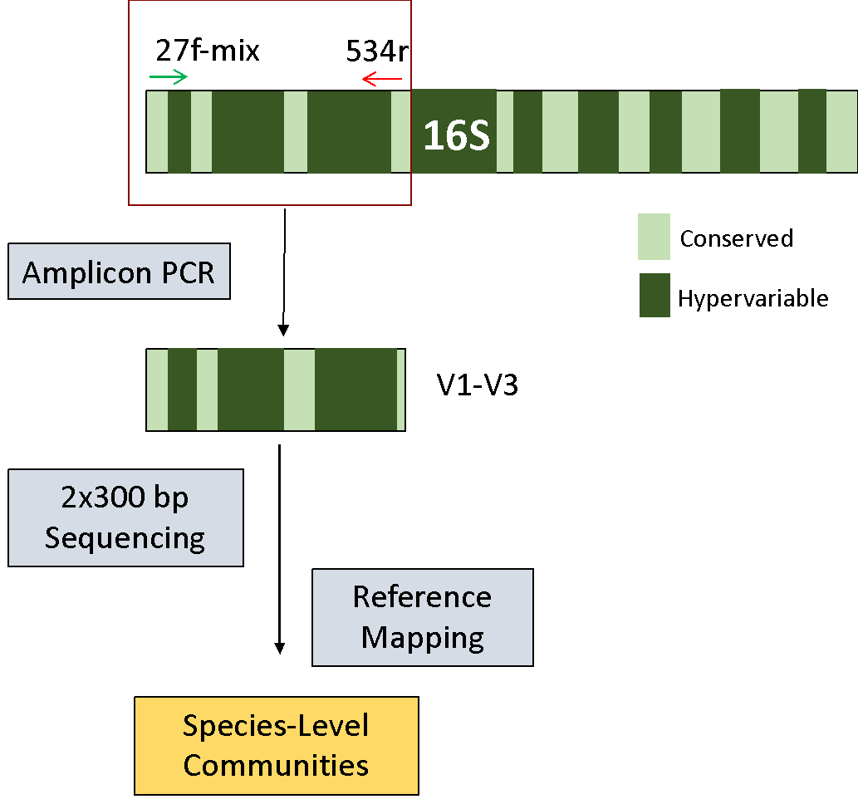
Amplicon Sequencing in Microbiome Studies
16S V1-V3 Amplicon Sequencing Strategy

Slide 26
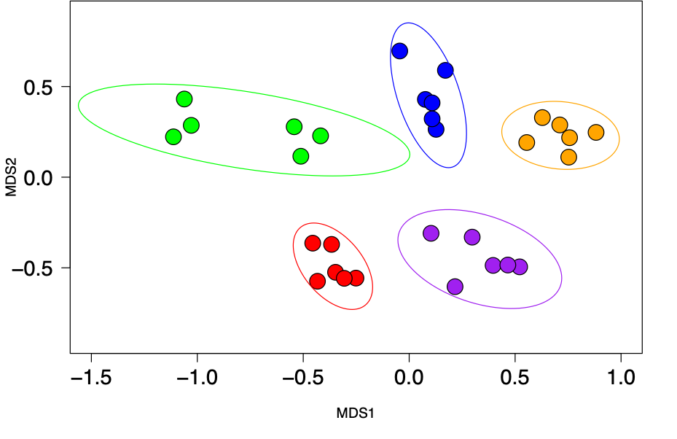
Amplicon Sequencing in Microbiome Studies
Mukherjee et. al., Microbiome, 2018
16S V1-V3 Amplicon Sequencing Strategy
NMDS Ordination shows oral microbiota of each subject (5 colors) remains distinct over 1 year (6 time points)

Slide 27
Bioinformatic Pipeline for 16S Amplicon Sequencing
MiSeq 2x300 bp paired-end Sequencing
Map against Reference Database
Quality Filtering, Adapter Removal
De-noising with DADA2
De-multiplexed paired FASTQ Files
High Quality Reads
Amplicon Sequence Variants
Species-level Taxonomic Data
Data Analysis
(Statistical Testing, Data Visualization)

Slide 28
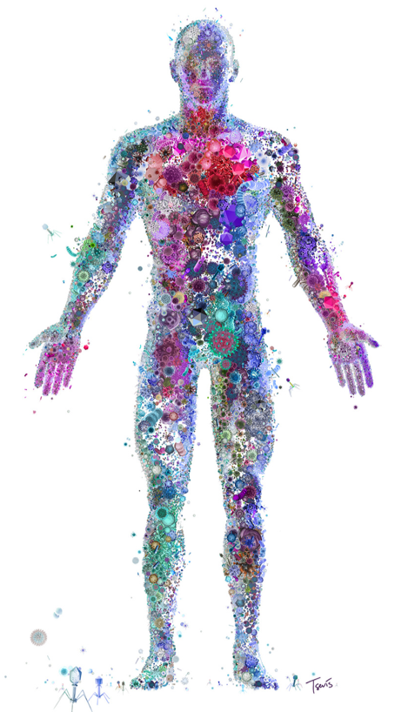
Challenges & Future Work
We are only beginning to understand the role of our microbiota in overall wellbeing
New developments in bioinformatic tools & techniques in the decade ahead will resolve several outstanding questions
Illustration: Charis Tsevis

Slide 29
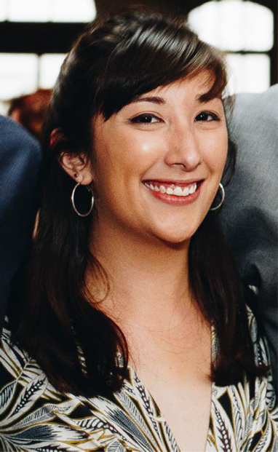
E. Sally Chang, PhD
Postdoctoral Fellow
National Human Genome Research Institute, National Institutes of Health
sally.chang@nih.gov
@esallychang
Notes:
Want to know if you encounter unwelcoming behavior outside or inside classroom

Slide 30
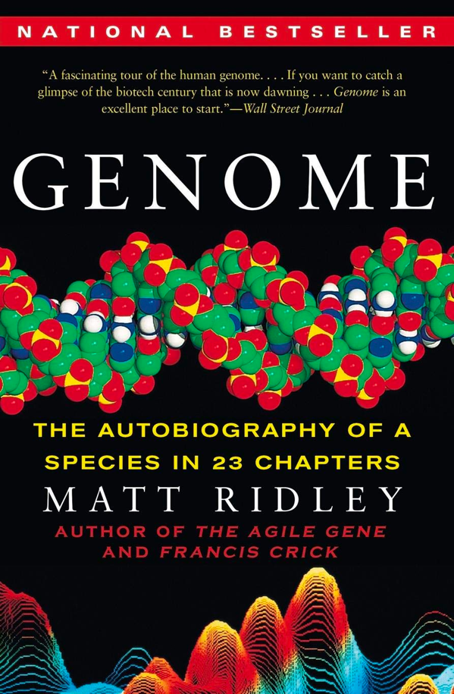
My science story
High School: In a program for communication arts, was 100% certain I would work in TV production… until I read this book for a book report in biology class!

Slide 31


The College Years
Knew I should be taking quantitative classes… but failed my first computer science course, and came close in some math classes
Working hard to improve my grades
Took classes in junior year that brought back my interest in genomics

Slide 32


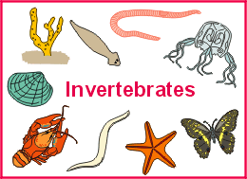


Applied to graduate programs
Getting a stipend

Slide 33
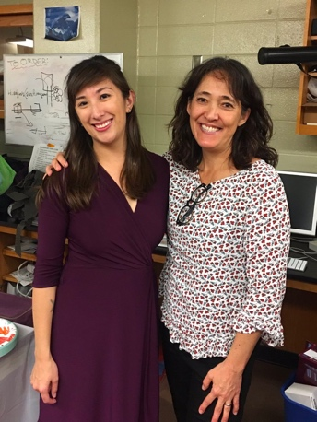

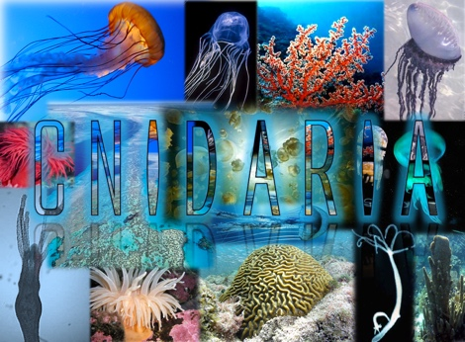
Applied to graduate programs
Getting a stipend
My advisor, Dr. Cartwright

Slide 34

Corals
“True”
jellyfish
Hydra:
A model for
regeneration
Sea
anemones
Notes:
Jellyfish and their relatives, so coral, sea anemones, Hydra, ---united by all having stinging cells
Diversity of habitats – everywhere from tropical reefs, to the bottom of the ocean, to the Great Lakes
And to exist in such diverse places, they display a diversity of life history traits – big sessile coloniality, free-living medusae, parasitism, solitary polyps, life cycles that include polyps and medusae
Plus, by studying their adaptations and the content of their genomes, we can learn about what the ancestral genome content may have looked like in animals since they are early diverging
Add “genome evolution” rather than just evolutionary biology

Slide 35
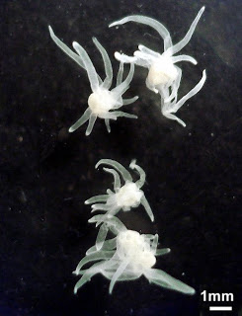
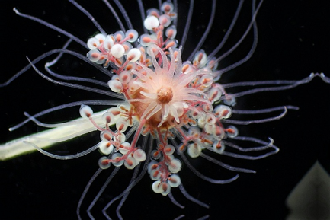
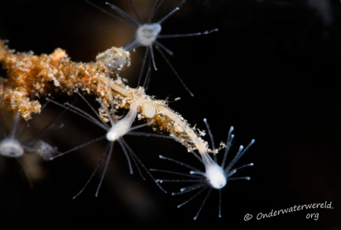
My PhD: Three evolutionary innovations within Cnidaria, addressed with genome-scale data
Parasitism
Transition between solitary vs. colonial forms
Freshwater tolerance
Notes:
Broadly, my research focuses on several species of cnidarians and the relationship between major life history transitions during their evolution and changes to genome content and population genomic patterns that accompany those transitions.
Thus far, this has been focused on on three super particularly unusual life history transitions that you may not think about when thinking about cnidarians
Can genomics inform us further about the evolutionary biology of these organisms?

Slide 36

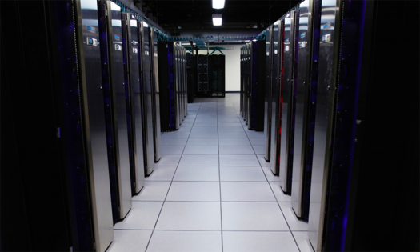
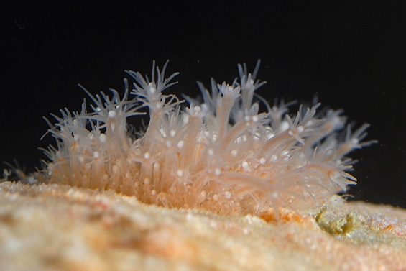
These days…
Postdoctoral Fellow in Computational and Evolutionary Genomics at the National Human Genome Institute
Can invertebrates serve as genomic models for human phenotypes and diseases?
What can we learn by making really high- quality genome assemblies and comparing them?
Making these resources publicly available

Slide 37

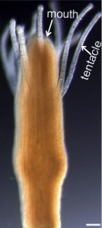
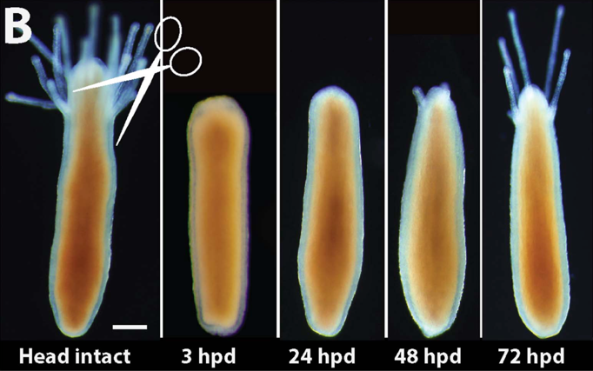
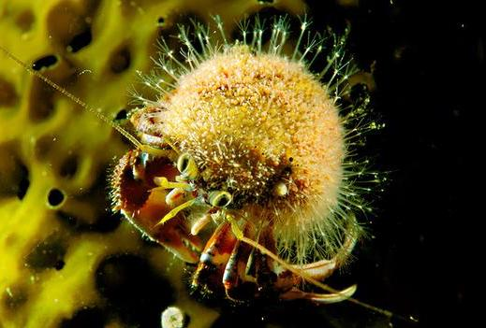
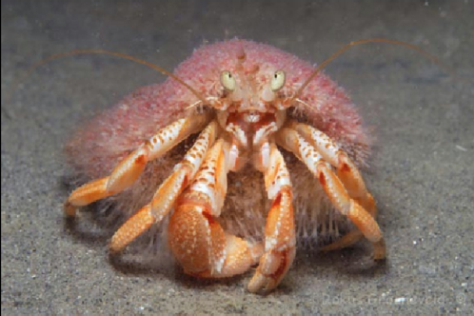
Hydractinia
Colonial marine cnidarian that grows on the surface of gastropod shells inhabited by hermit crabs
Excellent model for regeneration, immune system evolution, and stem cell biology
CRISPR and other molecular tools
Bradshaw et al., eLife 4: e05506 (2015)

Slide 38
My workflow: Using Sequence Data to Inform Model Organism Choice

Slide 39
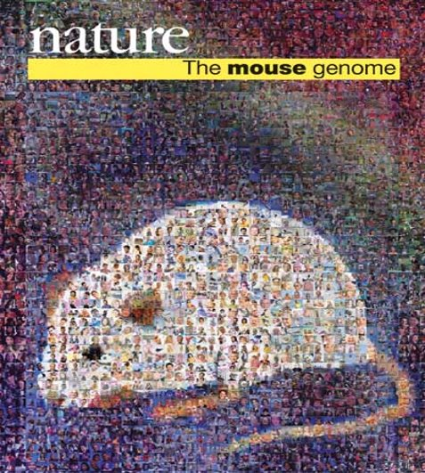
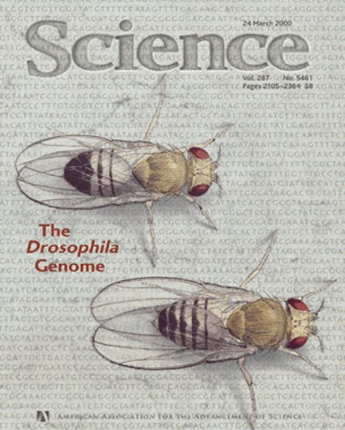


How to choose a model organism
Logistical considerations
Historical precedent
General applicability to human biology
Availability of genomic resources
Specific applicability to human trait
Evolutionary Genomics Approach: How can we systematically search for many interesting genes in many organisms at once?
Notes:
How can we broadly survey the available genetic data to teach us about many gene families of interest? Specifically, how can we broadly survey a number of organisms for a number of genetic pathways of interest?

Slide 40
Using evolutionary genomics for model choice
Orthology Inference
Figuring out which genes in different genomes are part of the same gene family
+
Phylostratigraphy
Using gene family information to assign evolutionary ages to genes
Notes:
We can do this in two steps: First, use sequence-similarity based methods to figure out which genes in different genomes are homologs. Then, use that information to assign evolutionary ages to genes while also accounting for gene losses. Now, what does this actually mean? And how does this help?

Slide 41

What does a gene’s age tell us?
For a gene family found in humans and yeast and some other species:
Common ancestor of yeast and human
Age: > 1.1 Billion Years
Range: Potentially in many metazoans + fungi, lots of models!
Notes:
On the other hand, a gene family that is found in humans and yeast and few other species likely evolved in the common ancestor of yeast and human and has potentially many other species that could be a model.
Once you have done this, you can do stuff like figure out which ortholog groups contain disease-associated genes and compare evolutionary histories of disease-associated genes and rest of human genes
Assess which other species have orthologs of these genes

Slide 42


The Phylostratigraphy Recipe
Gather our ingredients
FastQC
QUAST

Slide 43
The Phylostratigraphy Recipe
Gather our ingredients
Compare all sequences in all proteomes and infer hierarchical ortholog groups

Slide 44



Ortholog Inference using orthologous matrix algorithm (OMA 2.0)
Hierarchical Ortholog Groups
Sets of genes that have descended from a single common ancestor within a taxonomic range of interest
49 Protein Sets
Up-to-date species tree
Train et al. 2017
https://omabrowser.org/standalone/

Slide 45
The Phylostratigraphy Recipe
Gather our ingredients
Compare all Sequences in All Proteomes and Infer Hierarchical Ortholog Groups
Infer ages of gene families based on HOG content and extract the clusters containing human genes

Slide 46



Slide 47


The Phylostratigraphy Recipe
Gather our ingredients
Compare all Sequences in All Proteomes and Infer Hierarchical Ortholog Groups
Infer ages of gene families based on HOG content and extract the clusters containing human genes
Further analyses:
Evolutionary history of disease-associated genes?
Which organisms have which genes of interest?

Slide 48


























What do some of the results look like?

Slide 49

Diseases Genes in Select Taxa
Less-explored models have similar percentages of disease associated genes

Slide 50

Both cnidarians and Drosophila have ~40% of the human-disease- associated genes, but not the same subsets

Slide 51
Notably, Hydractinia has four disease gene orthologs not shared with other sequenced cnidarians
Increased taxon sampling is key!

Slide 52

Different Evolutionary History of Disease-Associated Genes
Significantly fewer recent origins among disease gene data sets
Significantly more pre-metazoan origins of disease genes
Disease-associated genes are more ancient on average!

Slide 53

sally.chang@nih.gov
@esallychang

Slide 54


Mario Banuelos, Ph.D.
www.mbgmath.com
Assistant Math Professor, California State University, Fresno
Applied Math, Math Biology, Predictive Modeling
Notes:
Want to know if you encounter unwelcoming behavior outside or inside classroom

Slide 55


Bioinformatics and ML
low-quality genomics data or clinical data
Leverage a priori information + computational or machine learning frameworks
Notes:
*Framing biological problems as mathematical ones often involves simplification of real-world phenomena.

Slide 56

Nonlinearity and Structural Variation (SV) Detection
*Framing biological problems as mathematical ones often involves simplification of real-world phenomena.

Slide 57

1000 Genomes
?

Slide 58
Gradient Boosting
Goal: Separate the blue circles from the red squares.

Slide 59
Gradient Boosting
Goal: Separate the blue circles from the red squares.
Weak
Classifier

Slide 60
Gradient Boosting
Goal: Separate the blue circles from the red squares.
Increase weights of misclassified

Slide 61
Gradient Boosting
Goal: Separate the blue circles from the red squares.
Weak Classifier 2

Slide 62
Gradient Boosting
Goal: Separate the blue circles from the red squares.
Increase weights

Slide 63
Gradient Boosting
Goal: Separate the blue circles from the red squares.
Weak Classifier N

Slide 64
Gradient Boosting
Goal: Separate the blue circles from the red squares.
Combine all weak classifiers

Slide 65
Gradient Boosting
Goal: Separate SVs from non-SVs.
Much more difficult problem than before
Map Quality of Paired Ends
Paired End Reads Supporting Deletion

Slide 66

1000 Genomes Results

Slide 67

Movie Recommendations and Epistasis
Netflix recommendation competition (2006)
Viewing SNV or GWAS data as users and movies
Goal: Detect Higher Order Interactions

Slide 68

Movie Recommendations and Epistasis
Netflix recommendation competition (2006)
Viewing SNV or GWAS data as users and movies
Goal: Detect Higher Order Interactions
Triángulo de Pascal by Pedro Sánchez, CC BY SA 4.0

Slide 69




A Nonlinear Path
First-generation, son of an immigrant, math professor
B.A., Math (Fresno State), Teaching Credential (CSUB), Ph.D. Applied Math (UC Merced)
MSRI-UP Postdoc (Summer 2018)

Slide 70
Student Resources & Contact Info
Getting Started w/ Machine/Deep Learning Resources
Computational linear algebra
Linear Algebra Review (3Blue1Brown)
Fast.ai
Ask for help
Professional/Community Development Resources
SACNAS
ABRCMS
MD4SG
Inclusion in ML
Email: mbanuelos22@csufresno.edu
Twitter: @mbanuelos22
Web: www.mbgmath.com

Slide 71
20 min Open Q&A

